Slide 1

Python Fundamentals
1. Getting started

Slide 2
Getting Started - Objectives
What is Python
Why learn and use Python
How is Python managed
How to Install Python
How to run Python programs
Interactive Prompt / IDLE
How does Python run your program
How to Install PyCharm
Other Resources

Slide 3
What is Python
Python was created by Guido Van Rossum year 1991
Python is an interpreted high level programming language for general purpose programming
Programming language is formal language which allows programmer to write specific instructions to be executed on computer.
Term ‘Python’ is also used for a software program called interpreter
Python interpreter is the program which reads, evaluates and executes instructions written using python programming language
Notes:
Default Python implementation of Python in Cpython
High level programming language is which uses natural language element

Slide 4
Why learn and use Python
Easy to learn, yet extremely powerful
Simple syntax
Advanced data structure
Software Quality
Easy to read/maintain code
Forces code indentations as per design
Developer productivity
No compile time
Lesser code in comparison to Java/C++
Strong support
Large collection of standard libraries
Strong community support
General purpose
Used for multipurpose e.g. automation/monitoring etc.
Notes:
Default Python implementation of Python in C Python
High level programming language is which uses natural language element
No Compile/build time

Slide 5
How is Python managed
Python Software Foundation (PSF) manages and oversees the development and roadmap for Python development
PSF is a non-profit organization which also organizes conferences and deals with intellectual property issues.
These conferences are called PyCon, and are organized in all major cities in the world
Notes:
Default Python implementation of Python in C Python
High level programming language is which uses natural language element
No Compile/build time

Slide 6
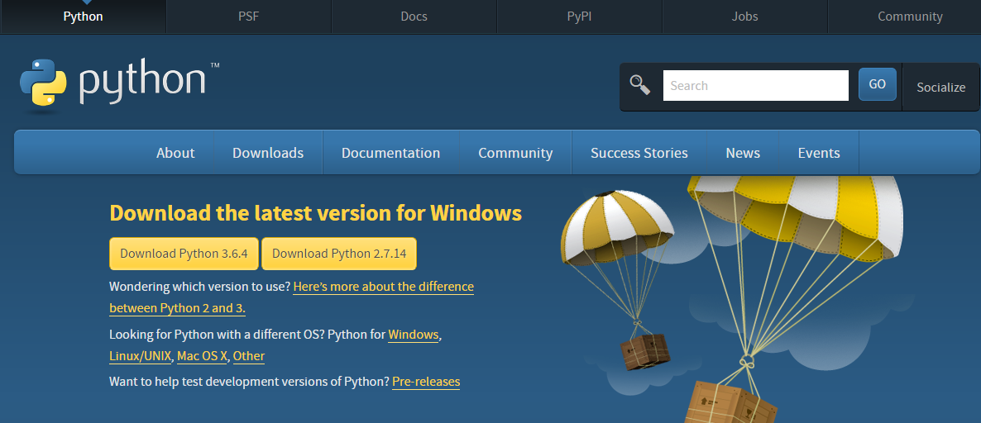
How to install Python
Python can be downloaded and installed from standard installers which are available on Python official website.
https://www.python.org/downloads/
You can get choose from various installers depending on the operating system and version you want to install.
Once the installer has finished the setup you can verify if the python is installed by typing the below command on the command prompt or terminal of your operating system
$ python --version
This will confirm if the python is installed and displays the version of the Python installed on your machine.
Notes:
Default Python implementation of Python in C Python
High level programming language is which uses natural language element
No Compile/build time

